Slide 1


Documentation - AspireEdge
Author: abdussami2307e@aptechgdn.net

Slide 2

CONTENTS
Table of Contents
1. Acknowledgement
2. Project Analysis
3. Problem Statement
4. Project Requirement
5. Functional Requirement
6. Non – Functional Requirement
7. Interface Requirements
8. Database Design
9. Task Sheet

Slide 3

01
Acknowledgement

Slide 4

Acknowledgement
We would like to express our sincere gratitude to Aptech Limited for providing us the opportunity to develop the AspireEdge – Career Passport: Future Path Explorer project. This project has enabled us to apply our knowledge in cross-platform development, understand real-world challenges in career guidance, and implement modern technologies to create a meaningful solution.
We are thankful for the constant guidance, encouragement, and support provided throughout this journey, which has been instrumental in shaping both our technical and professional skills.

Slide 5
02
Project Analysis

Slide 6

Project Analysis
AspireEdge is a cross-platform career guidance application that empowers students and professionals to make informed decisions about their academic and career journeys. The system provides tier-based navigation tailored to different user categories such as students, undergraduates, postgraduates, and working professionals.
It integrates features like a Career Bank for exploring professions, a Career Interest Quiz for personalized recommendations, Stream Selector for academic guidance, and CV and Interview Preparation tools. The app also includes a Resources Hub, Multimedia Guidance (videos, podcasts, expert talks, and panels), and a Testimonials Carousel. With email-based authentication, push notifications, and feedback forms, AspireEdge creates a complete digital ecosystem to support career planning.

Slide 7
03
Problem Statement

Slide 8

Problem Statement
Many students and young professionals face confusion and uncertainty while choosing the right career path due to a lack of structured, personalized guidance. Traditional solutions are often generic, outdated, and fragmented, leaving users without the clarity needed to align their strengths with career opportunities.
The challenge is to provide an interactive, engaging, and comprehensive platform that enables career exploration, self-assessment, and access to resources in one unified application. AspireEdge addresses this gap by delivering a personalized career passport experience.

Slide 9

04
Project Requirements

Slide 10


Project Requirements
Authentication: Secure email-based registration with verification and login.
User Categories: Student (Grades 8–12), Undergraduate, Postgraduate, Professional.
Career Bank: Career exploration industry and skills, with education paths.
Career Interest Quiz: Multi-Step quiz for personalized career suggestions.
Coaching Tools: Stream Selector, CV templates, interview questions, do’s and don’ts.
Resources Hub: Blogs, eBooks, videos, and gallery with search, filter, and bookmarking.
Multimedia Guidance: Videos, podcasts, career talks, and student panels.
Testimonials: Carousel of success stories.
Feedback Forms: For inquiries, bug reports, and suggestions.

Slide 11
Project Requirements
Notifications: Push alerts for updates and new resources

Slide 12

05
Functional Requirements

Slide 13



Authentication (Login/SignUp)
1
Users can register with their email, name, password, and selected tier.
2
Passwords must be securely stored in the database.
3
Registered users can log in to access tier-specific features.
4
Proper error handling and validation (email format and password strength) is essential.
5
After login, the username will be displayed at the top right corner.
6
Users can select their category (Student, Graduate, or Professional) for personalized content.
7
Each user tier will redirect to specific static or dynamic pages relevant to their career journey.
ADMIN: This option allows administrators to log in directly to manage administrative tasks, such as adding, modifying, or deleting records in the career bank, quizzes, and updating resources.

Slide 14
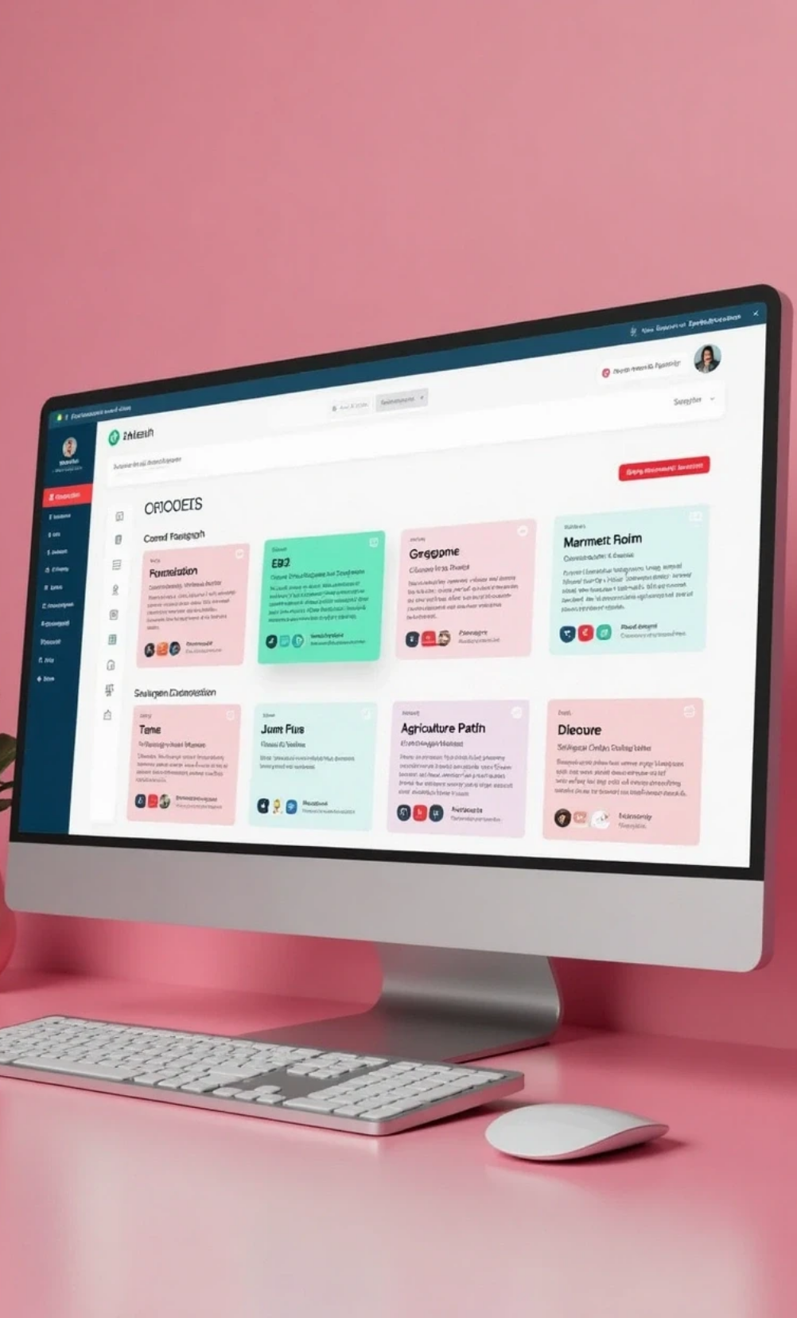

Career Bank
The Career Bank is a central feature that enables users to explore various career options.
Browse and filter careers by industry (IT, Health, Design, Agriculture, etc.).
Each career card displays:
• Title
• Short Description
• Required Skills
• Salary Range
• Education Path (Typical academic journey and recommended degrees or certifications required).

Slide 15



Admission and Coaching Tools
The Admission and Coaching Tools section provides essential guidance for academic and career advancement.
1
Static modules include:
• Stream Selector: Assists students in choosing the right academic stream based on interests and strengths.
• CV Tips: Offers resume formats, sample templates, and essential do’s and don’ts.
• Interview Preparation: Shares common interview questions, body language tips, and mock interview videos.
2
Content includes embedded videos and downloadable templates.

Slide 16


Resources Hub
A centralized library of curated content supporting users in their career exploration and skill development.
Categories include:
• Blogs, EBooks, Videos, Gallery
• Blogs covering career tips, trends, and expert advice; includes downloadable guides and study materials.
• Videos showcasing talks by industry experts and tutorials.
Allow filtering and searching of content by type.
Dynamic content loading via metadata from JSON files or databases.
Enable bookmarking or favoriting resources.
Create a wishlist of desired future content.

Slide 17





Career Interest Quiz
1
2
3
Implement a multi-step quiz using score mapping to guide users in assessing their interests and preferences.
Suggest a suitable career tier based on user responses, factoring in education level, interests, and goals.
Optional AI-powered quiz: Utilizes AI to provide personalized, data-driven career recommendations tailored to user inputs.

Slide 18


Multimedia Guidance
Include embedded videos and podcasts:
• Sessions featuring professionals sharing career journeys and advice.
• Podcasts covering skills, motivation, and current industry trends.
Content can be filtered by tags such as Experts, Career Talks, or Student Panels.

Slide 19


Testimonials/Success Carousel
This section highlights real stories from individuals who successfully navigated their career paths:
1
Rotating carousel displaying testimonials.
2
Each entry includes the individual’s name, image, and a brief success story.

Slide 20


Feedback Forms
A form to capture user feedback with fields for name, email, contact number, and feedback message, allowing for both positive and negative feedback (e.g., bug reports).

Slide 21





General Functionalities For Users
1
Contact Us:
2
Search, Sort, and Filter: Users can search, sort, or filter careers based on various criteria such as industry, salary, skills, title, etc.
• Inquiry form for submitting questions.
• Contact details for the app development team.
• Google Maps integration for locating offices.
3
Push Notifications: Users will receive notifications for new resources, blog updates, and quiz participation alerts.
4
User Profile: Users can view/update their profile, change passwords, and access their wishlist or bookmarked items.

Slide 22

18
Non-Functional Requirements

Slide 23




Non-Functional Requirements
1
2
Performance
Security
The app must offer high performance regarding speed and throughput, ensuring quick load times and smooth transitions.
Adequate security measures, such as data encryption and role-based access control, must be implemented.
3
4
Scalability
Accessibility
The app's architecture should accommodate increasing user traffic, data storage, and feature expansions.
Use clear fonts and intuitive user-interface elements to enhance usability.
5
6
Reliability
Data Backup
Ensure the app is available 24/7 with minimal downtime.
Scheduled auto-backups for records and logs should be established.
7
Offline Access
Certain resources, like blogs and quizzes, should be accessible offline.
These requirements represent the minimum expectations for the project. Upon completion, creative enhancements can be added as needed.

Slide 24

07
Interface Requirements

Slide 25

Interface Requirements
Hardware
Software
Testing

Slide 26






Interface Requirements
1
2
3
Hardware
Software
Testing
• Intel Core i7/i5 Processor or higher
• Programming Software and IDE:
• The app can be tested using a mobile device (Android Smartphone or iPhone) or a suitable emulator.
• 8 GB RAM or more
• Android Studio IDE with Android 9 or higher, utilizing Java
• Color SVGA monitor
• Flutter 1.2 with Dart 2.6 or higher
• 500 GB Hard Disk space
• Database: SQLite or Firebase
• Mouse
• Keyboard
• Internet access (4G or Wi-Fi)

Slide 27

08
Database Design

Slide 28
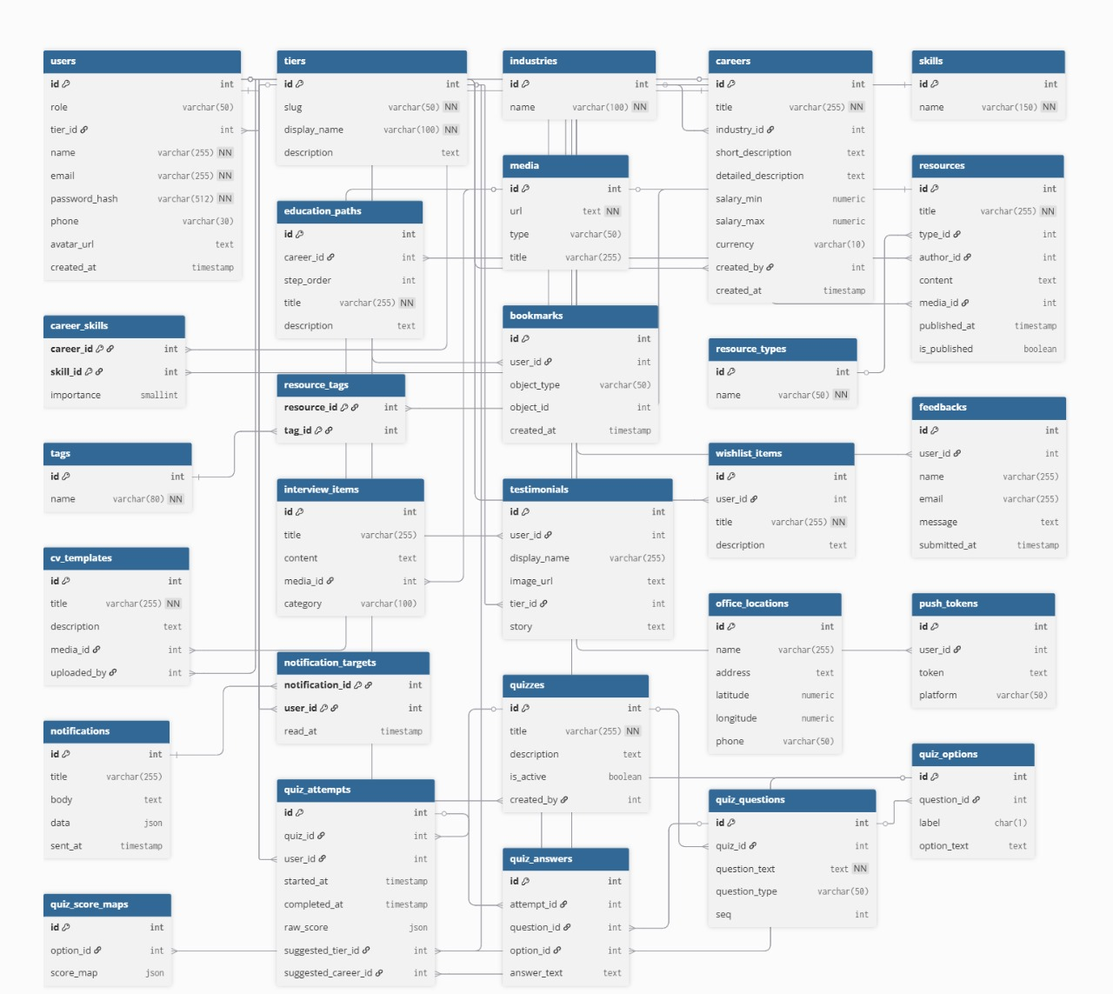

Slide 29
09
Task Sheet

Slide 30
Task Sheet
No. | Task Title | Start Date | Actual Days | Teammate Name | Status
01. | Requirement Analysis | 10-Sep 2025 | 6 - Days | Masoom Mallah | Completed
02. | UI / Frontend Development |  |  | Abdus Sami / Muhammad Zaid | Completed
03. | Backend Development |  |  | Muhammad Zaid / Masoom Mallah | Completed
04. | Integration & Testing |  |  | All Members | Completed
05. | Documentation & User Guide |  |  | Abdus Sami | Completed

Slide 31

Thank You

